Slide 1
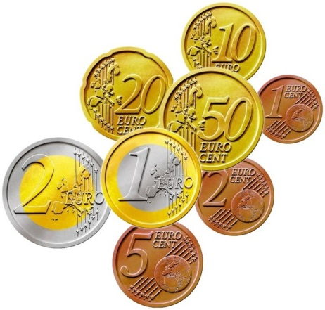
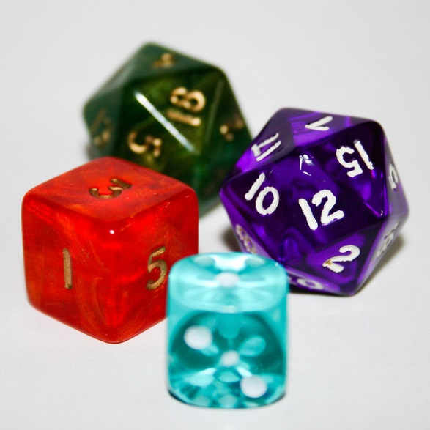

My Probability Interactive Notebook
Name
Class
Teacher
Term 1 Semester 1
1

Slide 2
Create your own front page
It needs to contain the following –
My number interactive notebook
Name
Class
Teachers Name
Semester 1 Term 1
Page number 1

Slide 3
Contents
Glossary or Formula Page
Page
Date
Description
2
3

Slide 4
Tasks
24
7
30
Essential Question
Questions
Notes
Summary
4
5

Slide 5
24
7
30
Date
Venn Diagrams
EQ – How can I put the information from a Venn diagram into a two-way table?
When the results of an experiment involve overlapping categories you can organise the information into a Venn diagram or two-way table.
These can then be used to calculate probabilities.
Example – Draw a Venn Diagram showing the number of students in the class with a brother or sister.
9

Slide 6
Notes Review
24, 7 ,30
Date
Title
Essential question
Notes complete
Notes complete with colour and diagrams
Questions completed
Contents page filed in
Formula page filled in

Slide 7
Homework
Review your notes and write a summary answering the essential question.

